Slide 1
EE0005 Mini Project
----Joe Cheng Kim Wei, Jet Ang Yu Sheng,
Liu Fayang, Liao Zhongtian

Slide 2
Objective
Predicting the type of cuisine based on ingredients selected

Slide 3

CONTENT
Dataset
Data Exploratory Analysis
Data Cleaning
Prediction
Conclusion

Slide 4
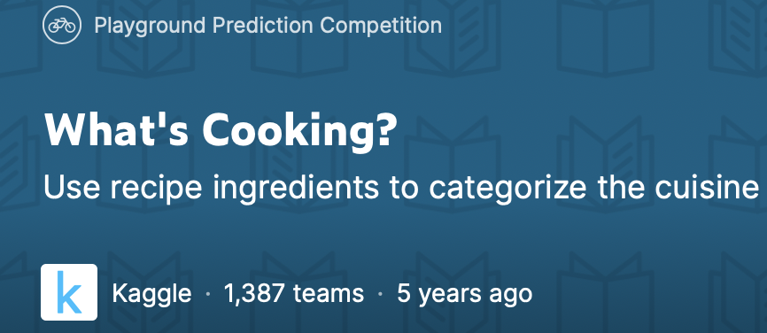
Dataset

Slide 5
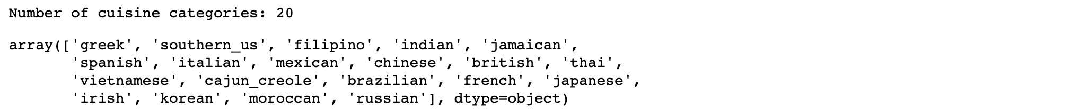
Data Exploratory Analysis

Slide 6
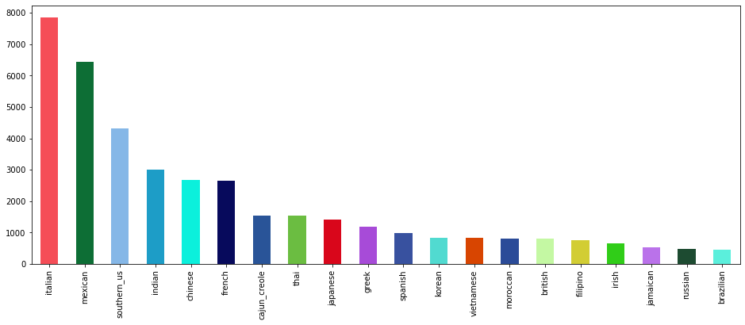
Notes:
How many cuisines for each category

Slide 7
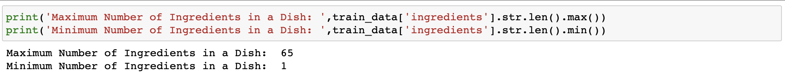
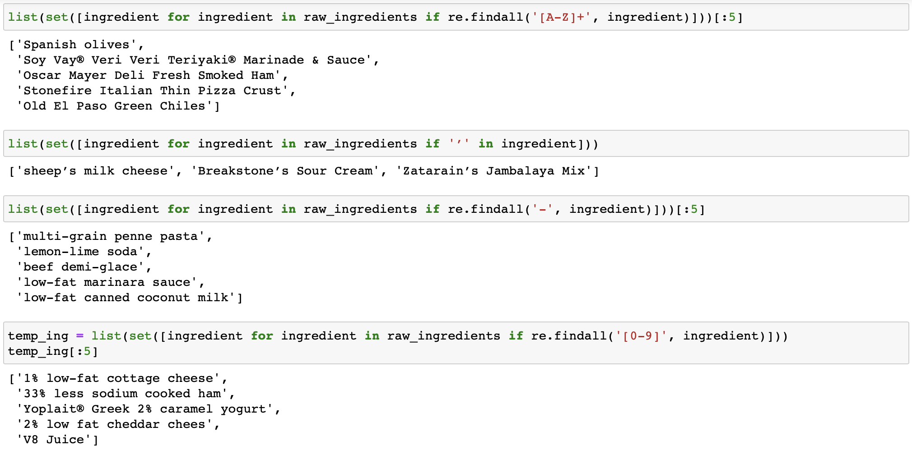
Data Exploratory Analysis

Slide 8
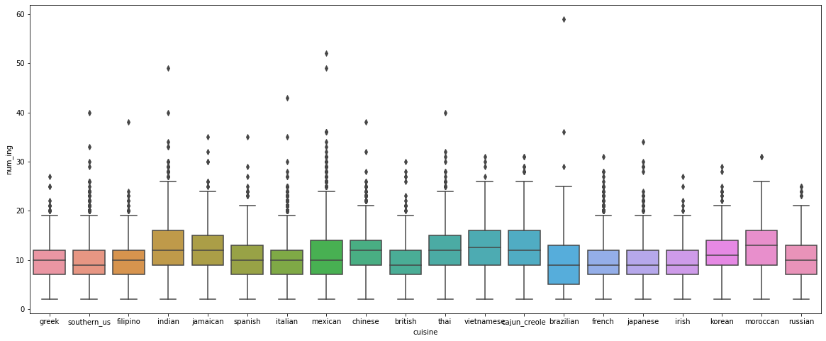

Slide 9
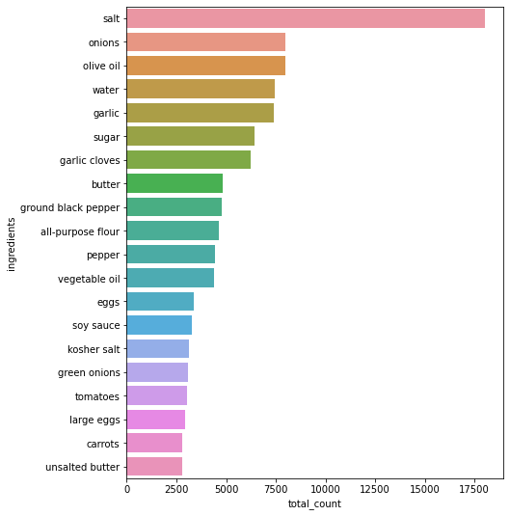

Slide 10
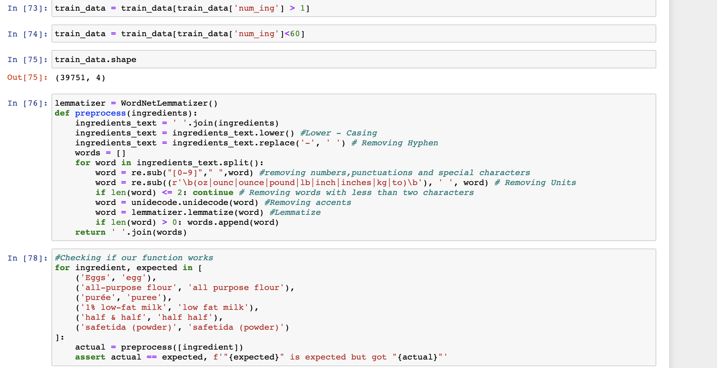
Data cleaning
Remove outliers
convert to lowercase
remove hyphen
remove numbers
remove words which consist of less than 2 characters
remove units
remove accents
lemmatize

Slide 11
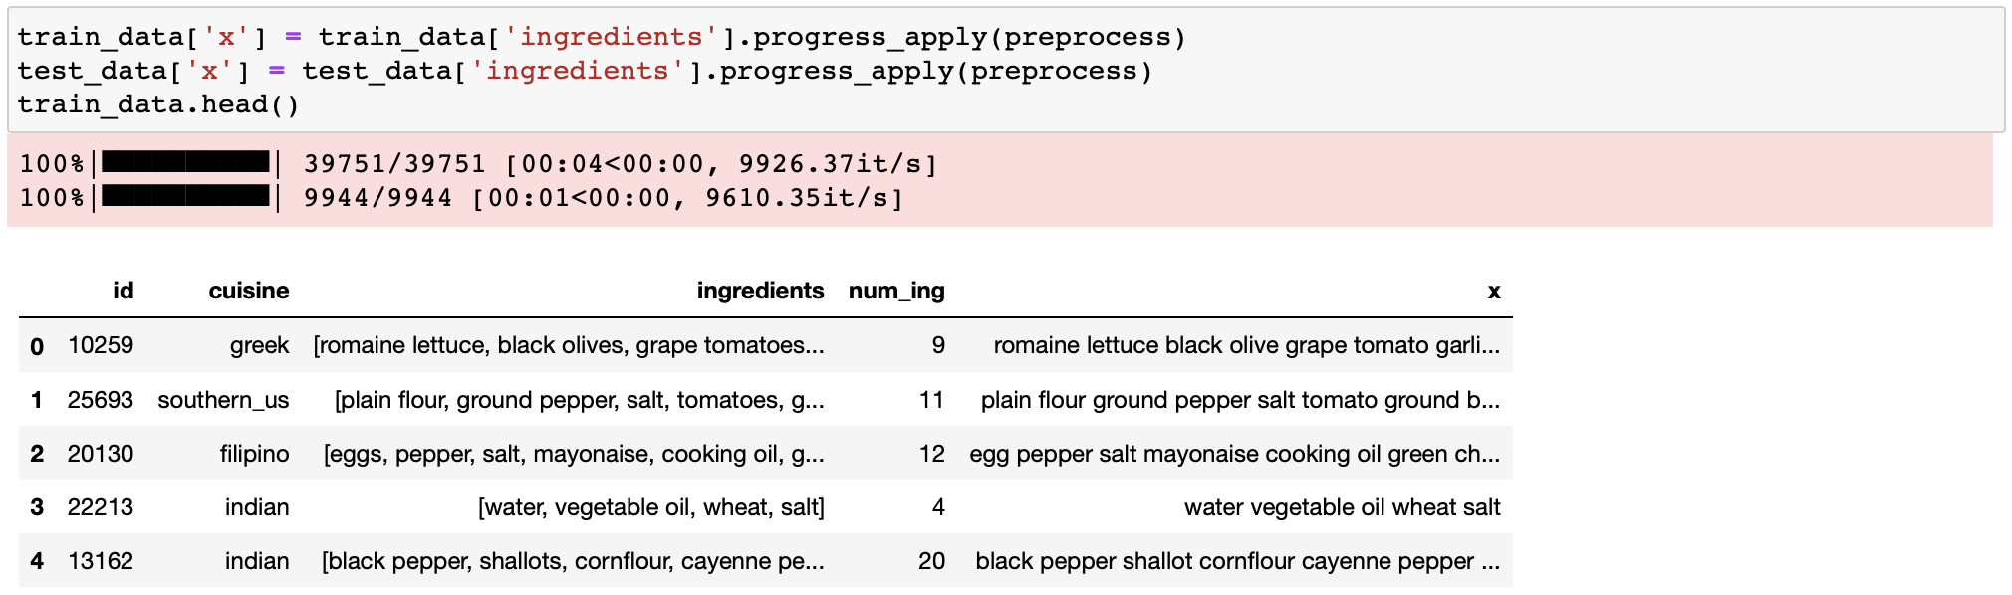

Slide 12

Dataset ⇒ Model ⇒ Prediction
Computers don’t understand words like egg, pepper, salt, italian, british.
For each recipe convert ingredients and cuisine types to one-hot vectors.
E.g. [0,0,0,1,0,0,1]

Slide 13
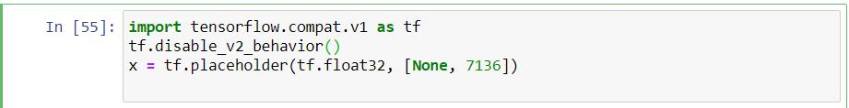
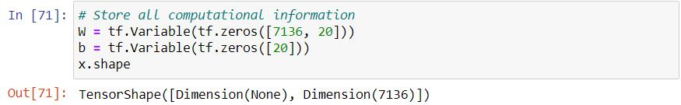
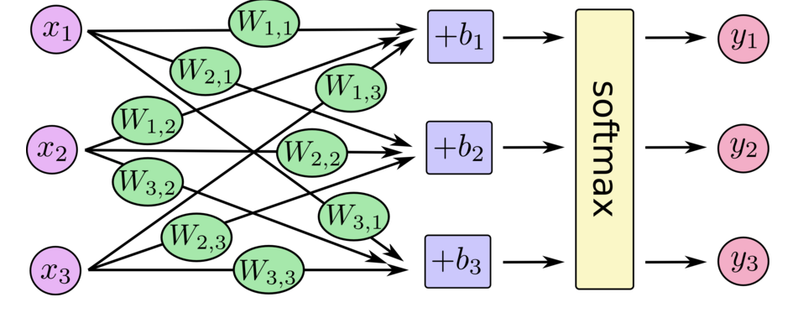
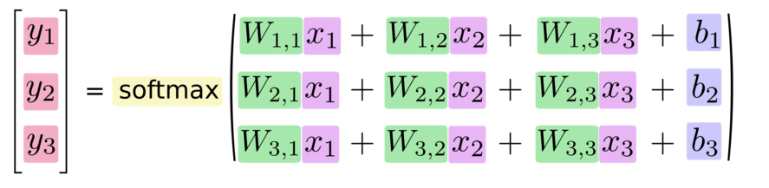

Slide 14
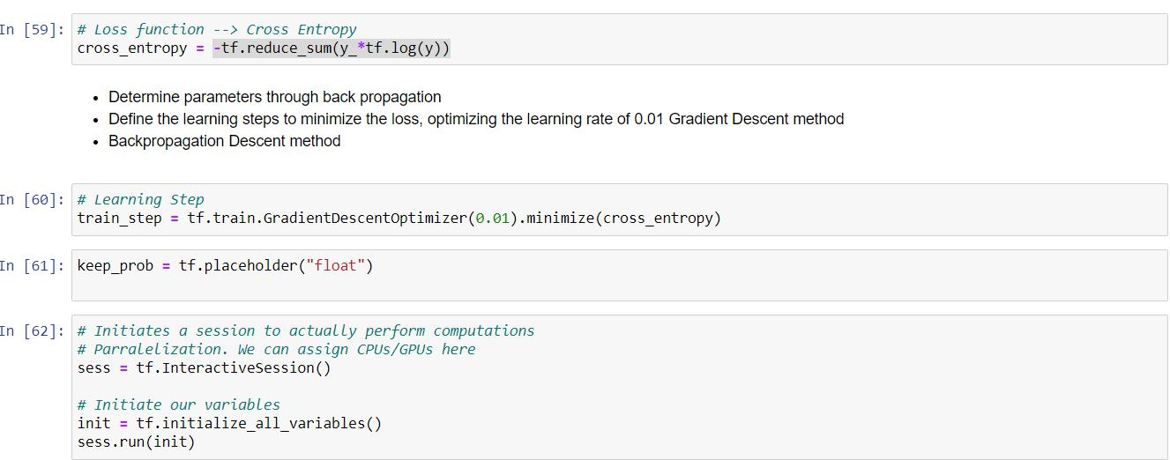
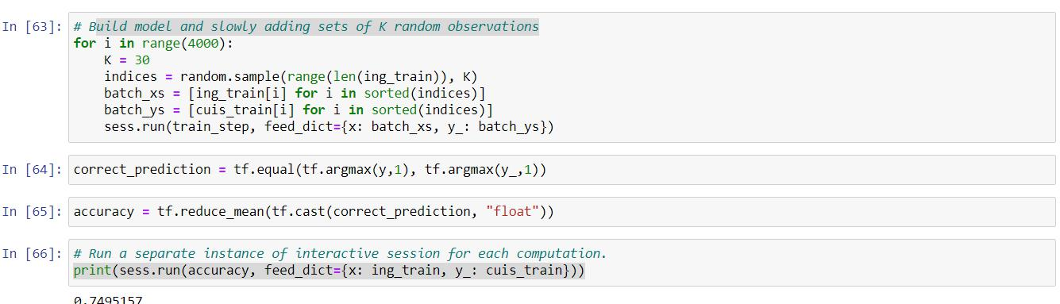
Improvement:
Multilayer Neural Network
Regularization

Slide 15
Conclusion
Initial objective ----> Outcome?
PART I: Exploration
(Joe, Jet) Cleaning
Visualization
PART II: Machine Learning & Prediction
(Fayang, Zhongtian)

Slide 16


